Slide 1



Sentiment and Aspect Analysis Using Machine Learning.
TEAM MEMBERS:
AASHIKA B S
DHANUSHRI M
COLLEGE NAME: Amrita School of Engineering, Coimbatore​
DEPARTMENT: Mathematics – Data Science​
​
REPORTING HEAD: Ms. Jothi Sekaran, Quality Lab Head​
DEPARTMENT: HP R&D, CDIT Lab
( Continuous Development & Integration Testing )
INTERNSHIP DURATION: 8 WEEKS

Slide 2

HIGHLIGHTS
Retrieving the data from web
DATA EXTRACTION
Problem Statement: Reading and classifying high volume of reviews manually is a tedious job for any product at any business organization.
Cleaning the data
Label encoding
Normalization and Scaling
DATA PRE-PROCESSING
ADVANCE
Develop a machine learning model to efficiently classify the reviews by reducing time consumption for the organization.
Unsupervised / Supervised Learning
Calculating accuracy
MACHINE LEARNING CLASSIFICATION
APPROACH
DISRUPT
Creating a new innovative tool to implement a Review classification model by incorporating Machine Learning with widespread impact in the business organization.
Analyzing the data to retrieve the hidden information
EXPLORATORY DATA ANALYSIS
TRANSFORM
Improve customer experience by identifying their needs, Helps organization to improve business strategies, Big data can be handled easily.
Improve Business
Revenue generation
Improve quality of product
IMPROVE CUSTOMER EXPERIENCE

Slide 3

ABSTRACT
In this modern world, people are profound of using different applications, which store vast amount of data, and it helps the organizations to improve their business strategies. One of the important data that helps the stakeholders to improve their business, are reviews and analyzing the reviews manually is difficult. So, machine learning model is developed to label and classify the customer reviews to predict their next move and by EDA, reviews can be analyzed broadly to get meaningful insights.

Slide 4




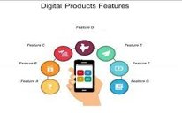


WHY SENTIMENT ANALYSIS?
Trends and patterns
Customer's satisfaction
Stakeholder's next move
Product's feature
Quality of the product
High data volume - Insights

Slide 5







Easy for classification and prediction
Less amount of time
No human input
WHY ML?
Meaningful insights
More accurate and efficient
Handles big data

Slide 6


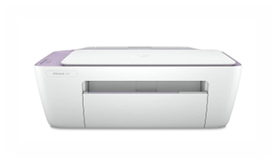
SAMPLE PRODUCT DETAILS
PRODUCT 1:
PRODUCT
WEBSITE
MODEL
NO.OF REVIEWS
LINK OF THE PRODUCT
HP
Amazon
HP 100 WIRED USB KEYBOARD
1186 AS ON 02/06/2022
HP-100 Keyboard
PRODUCT 2:
PRODUCT
WEBSITE
MODEL
NO.OF REVIEWS
LINK OF THE PRODUCT
HP
Amazon
HP Deskjet 2331
6965 AS ON 02/06/2022
HP-Deskjet

Slide 7



DESIGN AND WORKFLOW
WEB SCRAPING
DATA PRE-PROCESSING
MACHINE LEARNING
Request-Response
Tokenization
Feature Extraction
Ensemble Technique
Parse and Extract
Spell Check
Stop words Removal
Classification
Download Data
Stemming
Negation Handling
Accuracy
CSV Reader
DATA VISUALIZATION
Exploratory Data Analysis
Inference

Slide 8
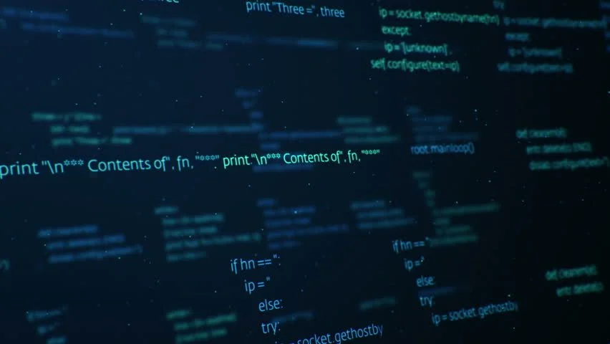
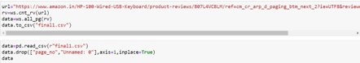
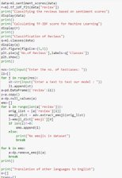
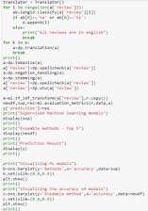
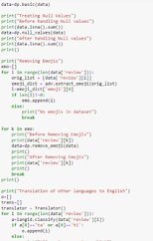
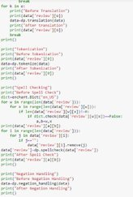
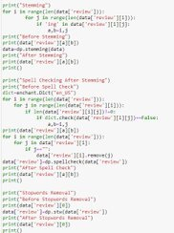
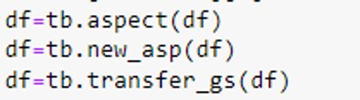
CODE
WEBSCRAPING
MACHINE LEARNING
DATA PREPROCESS
DATA VISUALIZATION

Slide 9

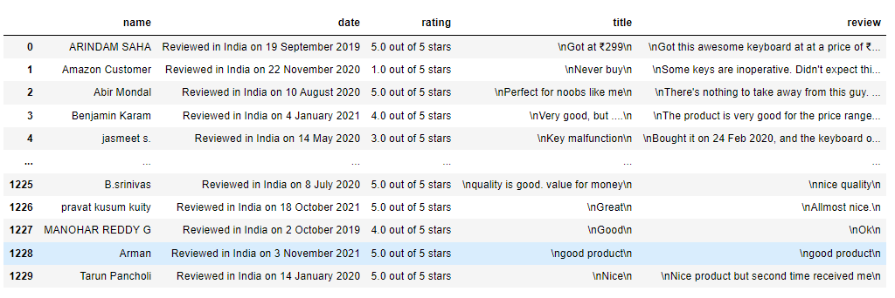
WEBSCRAPING

Slide 10


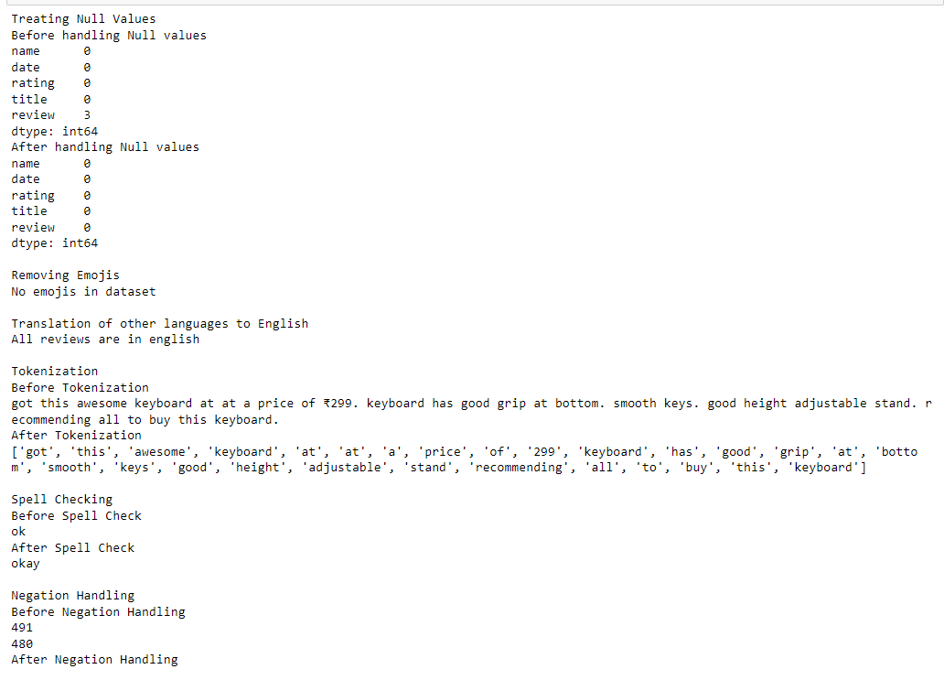
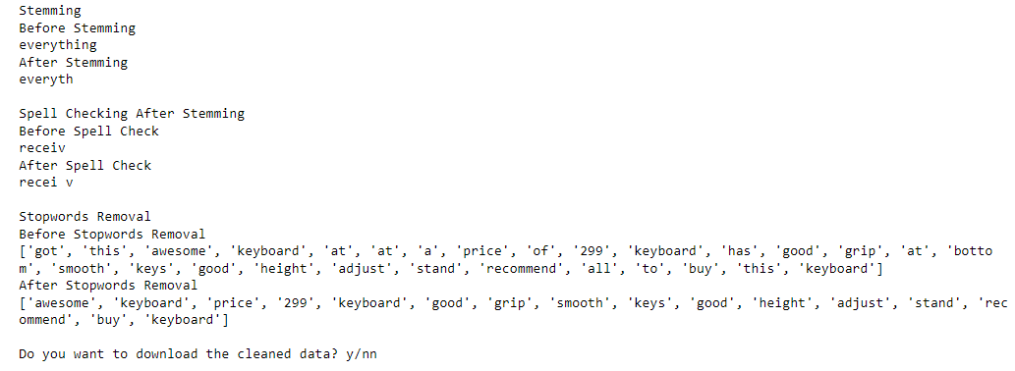
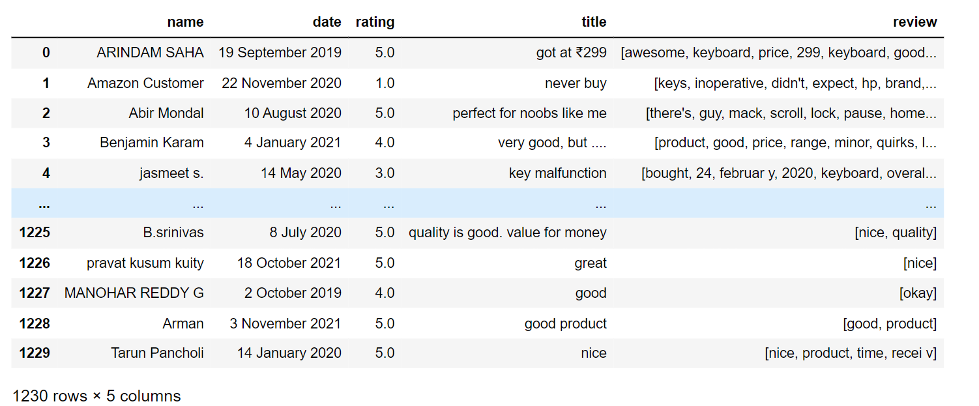
DATA PRE-PROCESSING

Slide 11

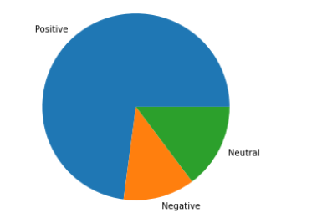
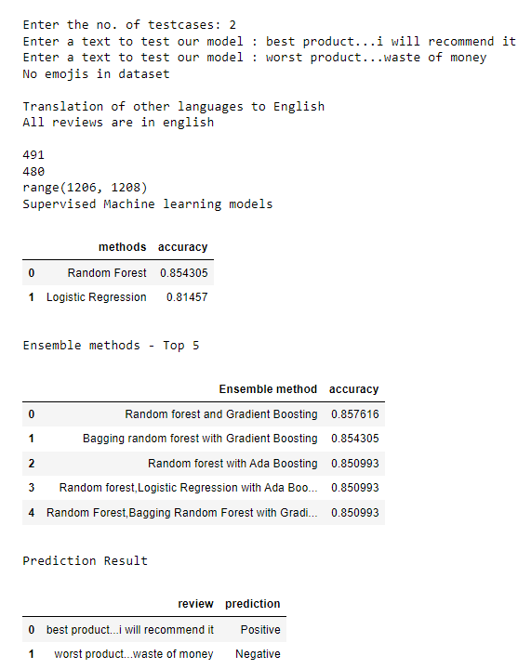
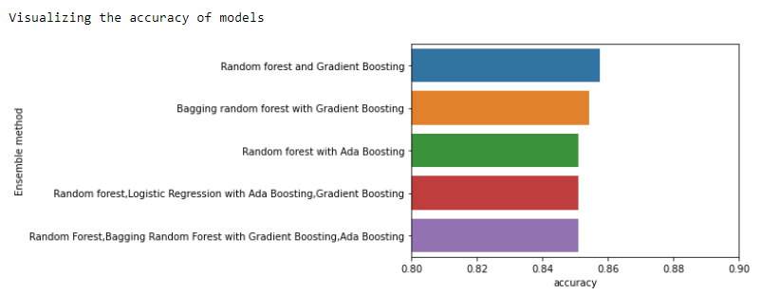
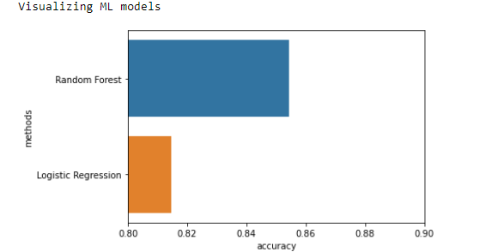
MACHINE LEARNING

Slide 12

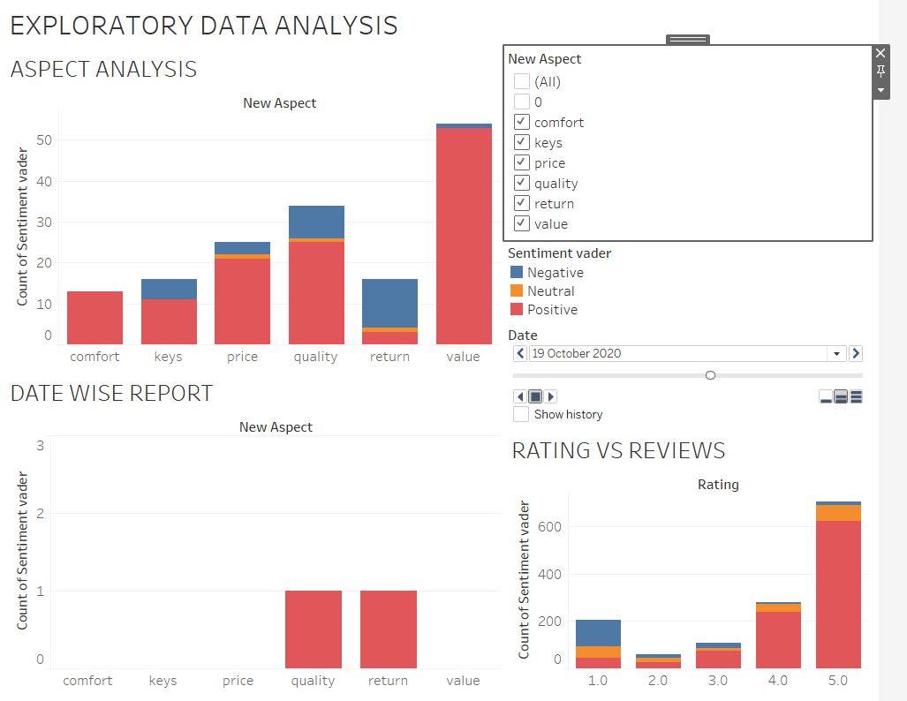
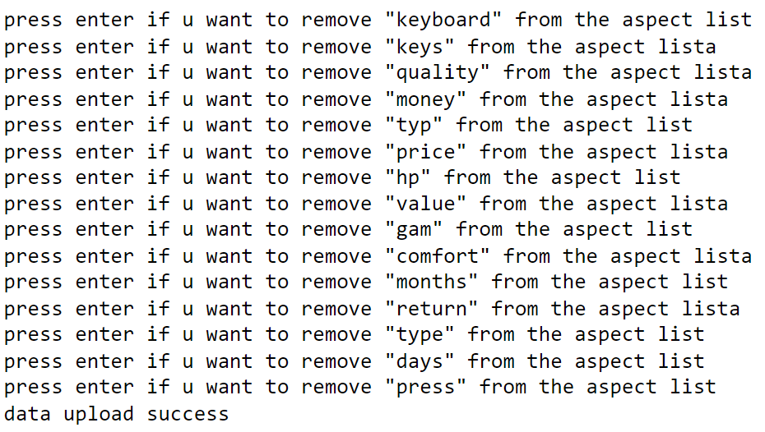
DATA VISUALIZATION

Slide 13

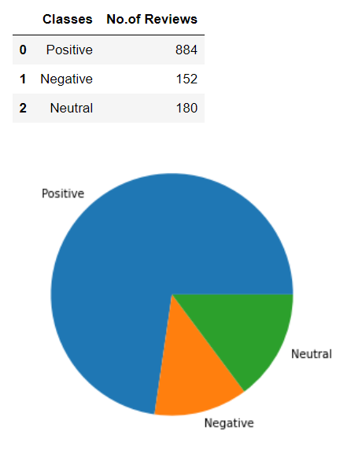
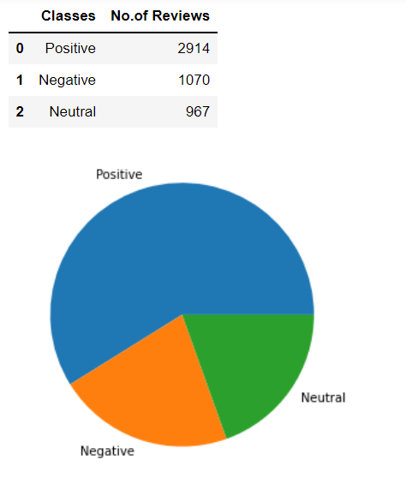
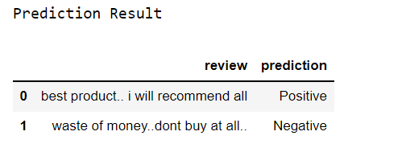
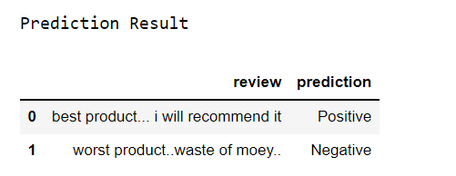
RESULTS OF SAMPLE PRODUCT 1 – HP WIRED KEYBOARD
RESULTS OF SAMPLE PRODUCT 2 – HP DESKJET

Slide 14


FUTURE SCOPE
Can be extended to classify the dynamic data by incorporating API.
This model can also be implemented in the field of text analysis.
Can be extended for fine grained sentiment, emotion detection, intent analysis, etc..
FOR ANY PRODUCT AT ANY ORGANISATION

Slide 15

STRATEGIES USED: AGILE
Individuals and interactions over processes and tools;
Responding to change over following a plan.
LEARNING OUTCOMES
Understanding the business review and situation, Handling enormous amount of data
WHAT
Gathering , visualizing and analyzing the data
DID
Identifying the trends and patterns from data
WE
Machine learning, python libraries and packages, web scraping tools, data visualization
LEARN
Completed SDLC (Software Development Life Cycle) strategy which produce superior software that meets and exceeds all customer expectations and demands.

Slide 16
THANK YOU!!

